Slide 1

Marketing Analysis
Bhavya priya N

Slide 2

Intro
You are a Marketing Analyst. The 'Sustainable Clothing Co.' have been running several marketing campaigns and have asked you to provide your insight into whether they have been successful or not. Analyze the following data and give answers for the requirements.

Slide 3
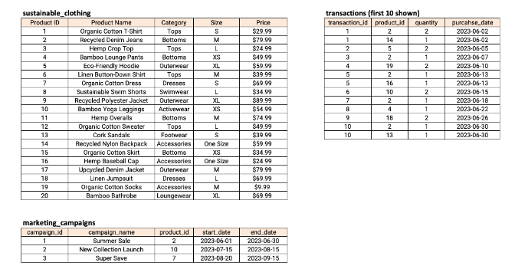
Tables Here are the data

Slide 4
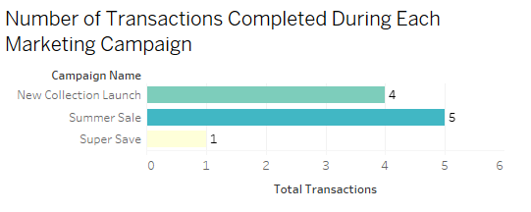
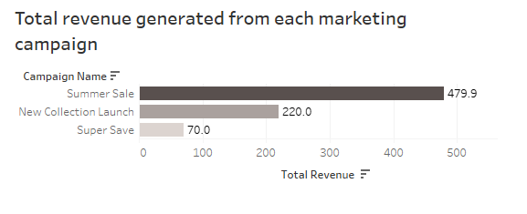
How many transactions were completed during each marketing campaign?
What is the total revenue generated from each marketing campaign?

Slide 5
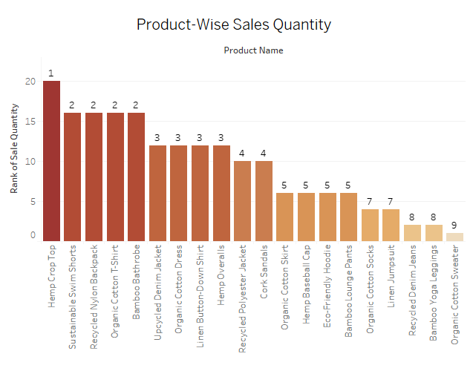
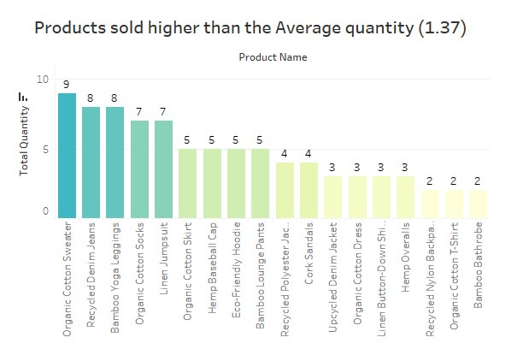
Which product had the highest sales quantity?
Which products had a higher quantity sold compared to the average quantity sold?

Slide 6
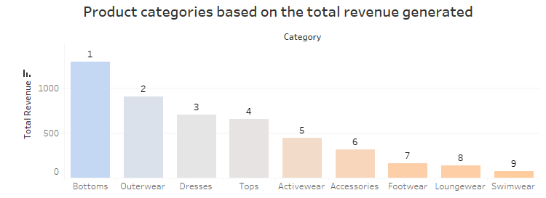
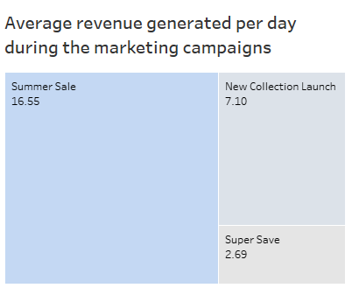
What is the average revenue generated per day during the marketing campaigns?
What is the top-selling product category based on the total revenue generated?

Slide 7
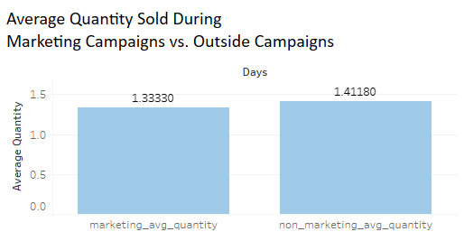
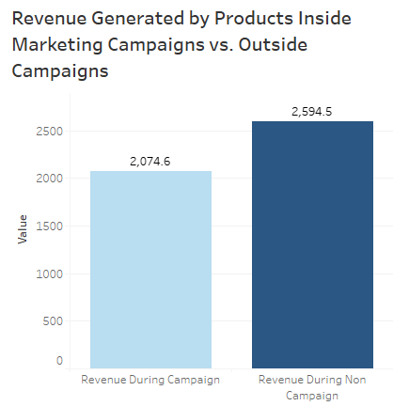
Compare the revenue generated by products inside the marketing campaigns to outside the campaigns
Compare the average quantity sold during marketing campaigns to outside the marketing campaigns

Slide 8
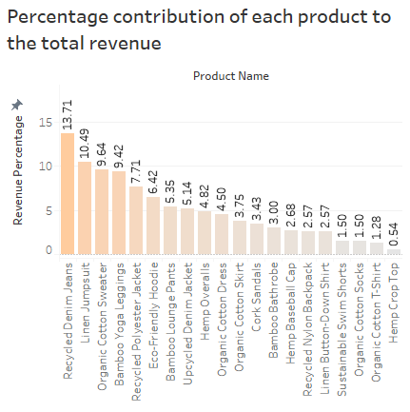
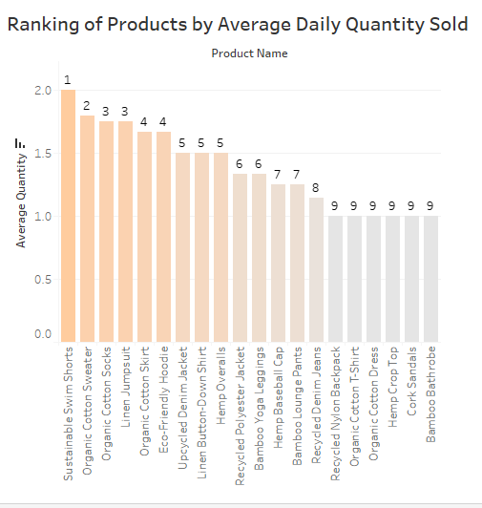
What is the percentage contribution of each product to the total revenue?
Rank the products by their average daily quantity sold

Slide 9
Thank you
Bhavya priya N
Dashboard link 1 - Marketing 1
Dashboard link 2 - Marketing 2

